Slide 1
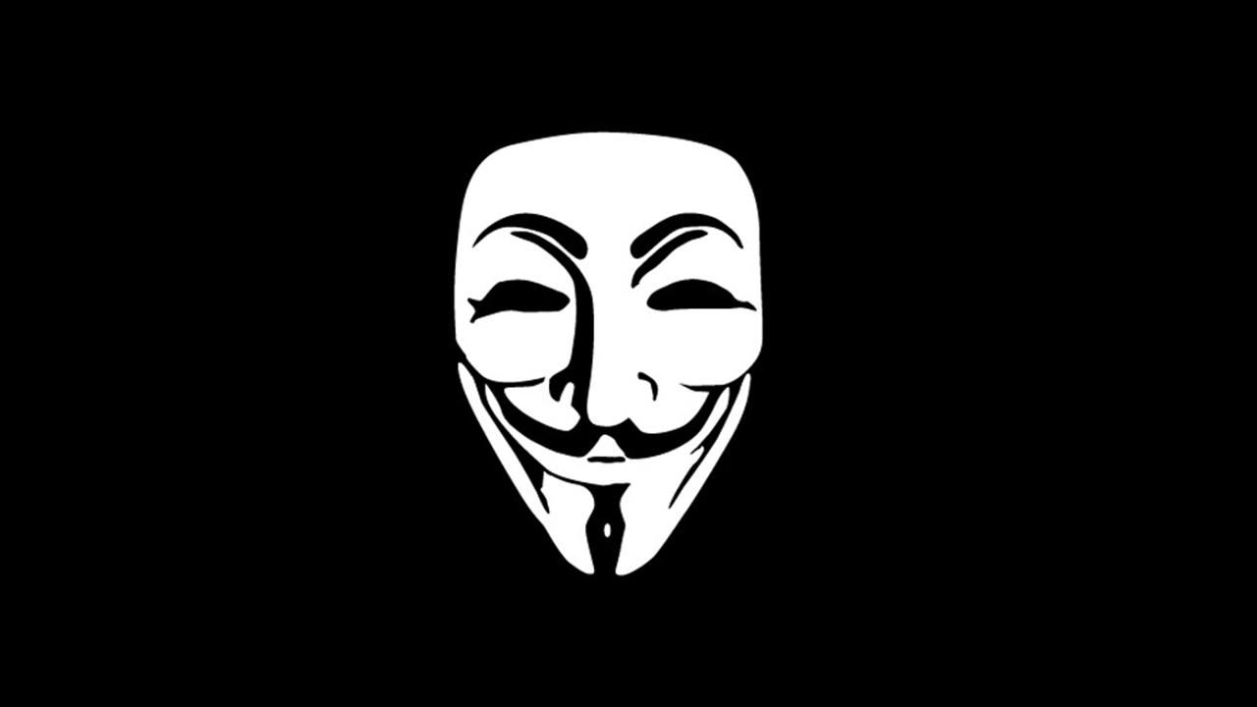
Riga Technical University
Assignment in subject
Civil defence
Hacktivism
Said Naghiyev(201ADB100)
Khurshedjon Khaitov (191ADB089)
Bekzod Kuziev (201ADB012)
Sanan Shahverdi (201ADB063)

Slide 2
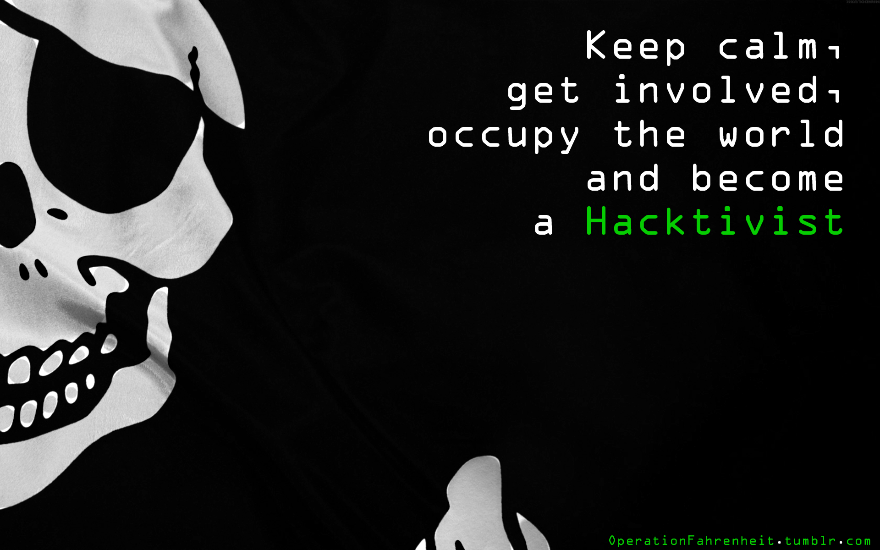
What is Hacktivism?
Derived from combining the words ‘Hack’ and ‘Activism’, hacktivism is the act of hacking, or breaking into a computer system, for politically or socially motivated purposes.
The individual who performs an act of hacktivism is said to be a hacktivist.

Slide 3
Targets
Common targets for hacktivists include government agencies, multinational corporations, or any other entity perceived as ‘bad’ or ‘wrong’ by the hacktivist group or individual.
Hacktivism is not about breaking into people's computers necessarily. It’s about curiosity which may include the former but not necessarily. It’s about computer innovation, sharing information (including that which is private).

Slide 4
How Hacktivism Works
01
02
03
04
05
Removing censorship and Protecting free speech online.
Promoting access to information
Assisting computer users in protecting their privacy and avoiding surveillance through secure and anonymous networks such as Tor and the Signal messaging app
Disrupting corporate or government power
Halting the financing of terrorism
Taking down government websites that pose a danger to politically active citizens

Slide 5
How Hacktivism Works
Hacktivists’ methods may include distributed denial of service (DDoS) attacks, which flood a website or email address with so much traffic that it temporarily shuts down; data theft; website defacement; computer viruses and worms that spread protest messages; taking over social media accounts, and stealing and disclosing sensitive data

Slide 6
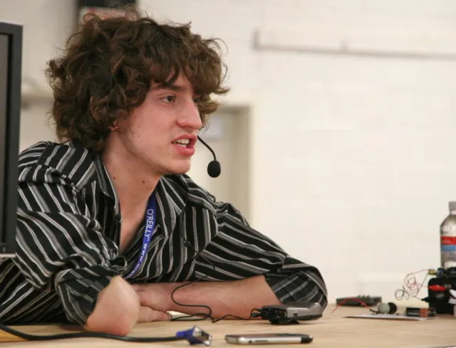
Geohot (Egohot)
George Francis Hotz

Slide 7
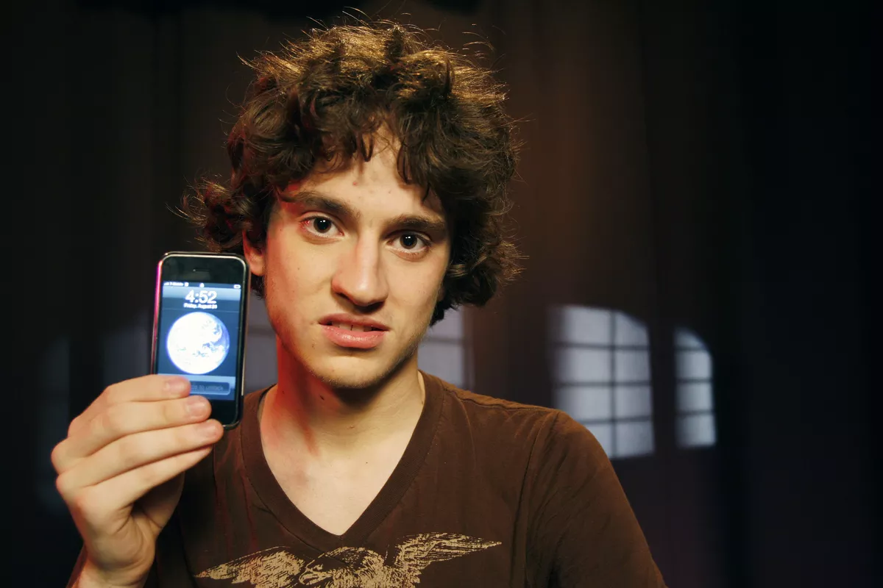
EGOHOT
George Francis Hotz (born October 2, 1989), is an American security hacker.
17 years old egohot is the first person who removed simlock on iPhone. After 2 year he released blackra1n(jailbreak of ios 3.x). but it is not honest work.
Most of the hacking is done in a community as a group, in this case, IRC chatrooms where like minded people collaborate and share ideas with each other. The already established iPhone dev team back then was very open and sharing information and IDB’s with everyone (those are Interactive Disassembler [IDA] files containing application binary and assembly code annotations).

Slide 8

EGOHOT
From there George Hotz collected as much information and already established work from the iPhone dev team as he could. And in doing so learning the skill of the trade: reverse-engineering the components that make up the iOS system.
However, instead of sharing back to the hacking community, George Hotz kept most of his findings to himself and tried to be the center of attention. This is why he got the nickname Egohot.

Slide 9
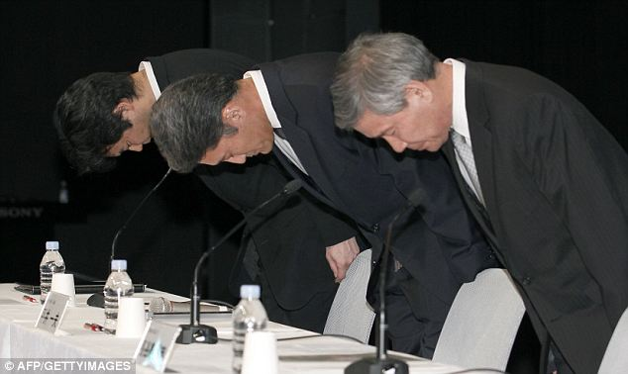
PlayStation 3

Slide 10


PlayStation 3
EARLY DAYS
Back in the day, many people use the crack of the games to play on consoles. Because the security of games is not developed and many hackers making games for free to play. Eventually, sony released playstation3 with “developed” protection. After this many people begin to buy the original games or exchanged with each other.

Slide 11
EGOHOT JOINING
Hackers could not break the system. This situation is good for Sony.
in 2010, egohot joined this problem. And he shared the ps3 system configuration. Sony did not like that. In 2011 egohot hacked the system and published this hack with other people on his website.

Slide 12
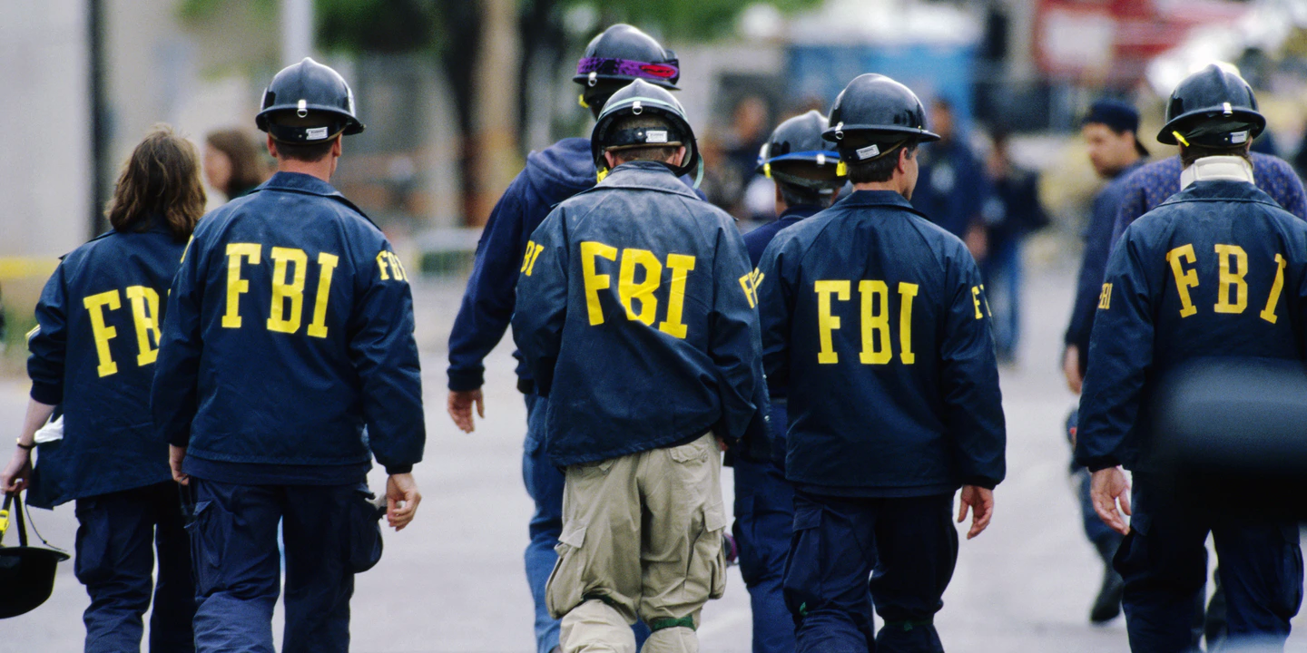
Sony report this problem to the FBI and egohot website had shutdown. A group of people began to protest this move. As expected, hackers got to work.

Slide 13
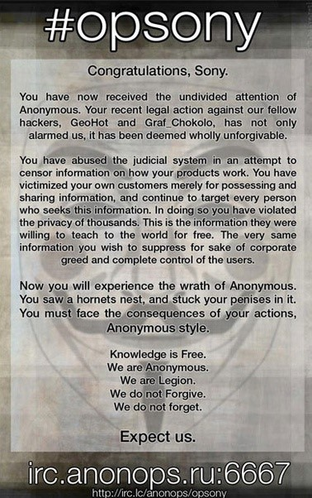
The hacker team hacked PSN(PlayStation Network) and Sony shut down their servers. This problem affects online gaming and industries. After this situation, 77milion users account information has been exposed.

Slide 14
After few days Sony made a conference with peoples and the CEO of Sony Kaz Hirai apologized to people and the hacker group. They also admit that their security systems are weak.

Slide 15
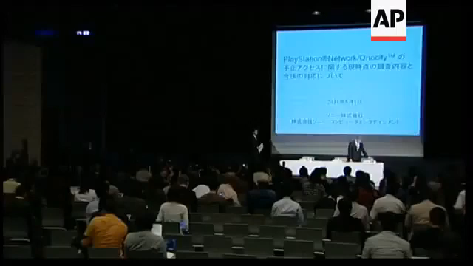
Regarding the possibility of leakage of personal information of the accounts of users who have registered for the PayStation Network. We deeply apologize for the inconvenience caused to our users.

Slide 16
Sony
But in PlayStation 4 they released PlayStation Network again with mandatory for online games. But people did not say anything.
Maybe people are fish minded. They forgot everything

Slide 17
Last Words
This show breaking into systems may seem malicious at first but it drives people to fix security problems in their systems.
There is only one way to prevent this.
Make a good system, not an unfinished product

